Slide 1

First steps in Scala

Slide 2
Why Scala?
Functional Programming Language
Object-Oriented
Statically Typed
Concise
Scala programs compile to JVM bytecodes

Slide 3



Who is using it?
IBM
Xerox
Novell
Sony
The Guardian
Many more...
Notes:
http://www.youtube.com/watch?v=ohHdZXnsNi8
http://www.meetup.com/Scala-Bay/events/69365452/?action=detail&trax_also_in_algorithm2=original&eventId=69365452&traxDebug_also_in_algorithm2_picked=original
http://alvinalexander.com/scala/whos-using-scala-akka-play-framework

Slide 4
Common questions
Is Scala a better Java?
Is Scala really complex?
Can I start using it without going mad?
Is it all roses?
Should my enterprise change all it’s stack to Scala?

Slide 5
Tools and Frameworks
Scala SDK
Simple Build Tool (SBT)
Scala IDE (based on eclipse Kepler)
Intellij Scala plugin
Play Framework, Lift, Spray, Scalatra (Web frameworks and Web API toolkits)
Akka (Actor model library)
Slick (database query and access library)
Finagle (protocol agnostic RPC)

Slide 6
Demo 1 – Hello World SBT

Slide 7
Demo 2 – Hello World SDK

Slide 8
Demo 3 – REPL

Slide 9
Demo 4 – Dependencies with SBT

Slide 10
Demo 5 – Scala IDE Worksheet

Slide 11
Scala World
Prefer immutability
Use matematical functions, i.e. functions that given some input values produce a result
Functions have result types
void methods don’t exist, the closest thing is a function whose result type is Unit
Functions are first-class citizens
Write less or none loops (while, do while)
Type inference

Slide 12
Prefer immutability
val i = 1 // Type inference here
i = i+1 /* doesn’t compile, is like final variables */
var i : Int = 1
i = i+1 // compiles

Slide 13
Use mathematical functions
def max(i1: Int, i2: Int): Int = {
if(i1 >= i2) i1 else i2
}
Note: Curly braces are optional in one statement functions.
def factorial(n: BigInt): BigInt =
if(n == 0) 1 else n * factorial(n -1)

Slide 14
Demo 6 scala.collection.immutable.List

Slide 15
Functions have result types
“In absence of any explicit return statement, a Scala function returns the last value computed by the function”
“Functions with a result type of Unit are executed for their side effects”
def printList[T](l: List[T]): Unit = println(l.mkString("[", ",", "]"))

Slide 16
Functions are first-class citizens
val doubled = (x: Int) => x * 2
doubled(3)
val and = (a: Boolean, b: Boolean) => a && b
val nand = (a: Boolean, b: Boolean) =>
! and(a, b)
and(true, false)
nand(true, false)

Slide 17
Tail recursion optimization
@tailrec
def factorial(n: BigInt): BigInt = {
def loop(acc: BigInt, n: BigInt) : BigInt =
if(n == 0) acc else loop(acc*n, n-1)
loop(1,n)
}
If you use @tailrec (scala.annotation.tailrec) annotation, the compiler will issue an error if the function cannot be optimized into a loop.

Slide 18
Conciseness so far
Type inference (Is that good?)
Semi-colon inference
Optional curly braces

Slide 19
Object-Oriented Programming
Class
Object
Case class
Abstract class
Trait
Properties

Slide 20
Class
class Book (_title: String, _authors: Array[String]) {
private val id: Int = 0
val title = _title
val authors = _authors
}
val book = new Book("1984", Array("George Orwell"))
book.title
book.authors(0)

Slide 21
Class
class Book (
val title: String,
val authors:Array[String]
)
{
private val id: Int = 0
}
val book = new Book("1984", Array("George Orwell"))
book.title
book.authors(0)
Notes:
Auxiliary Constructors in Scala must either call the primary constructor (as in landon9720's) answer, or another auxiliary constructor from the same class

Slide 22
Object (built-in Singleton)
object WarAndPeace {
val title: String = "War and Peace"
val authors: Array[String] = Array("Leo Tolstoy")
}
WarAndPeace.title
WarAndPeace.authors(0)

Slide 23
Abstract class
abstract class Greeter {
val message: String
def sayHi() = println(message)
}
class PortugueseGreeter extends Greeter {
val message = "Olá mundo!"
}

Slide 24
Trait
“A trait encapsulates method and field definitions, which can then be reused by mixing them into classes.”
trait Philosophical {
def philosophize() =
println("I consume memory, therefore I am!")
}
class Student extends Human with Philosophical with …

Slide 25
Case class
abstract class Term
case class Var(name: String) extends Term
case class Fun(arg: String, body: Term) extends Term
case class App(f: Term, v: Term) extends Term
“Case classes are regular classes which export their constructor parameters and which provide a recursive decomposition mechanism via pattern matching.”

Slide 26
Case class
Scala compiler add some syntactic conveniences to your class:
Factory method with the name of the class
All arguments in the parameter list get a val prefix, so they are maintained as fields
“Natural” implementations of methods toString, hashCode and equals
Copy function for making modified copies

Slide 27
Case class and Pattern Matching
def simplifyTop(expr: Expr): Expr = expr match {
case UnOp("-", UnOp("-", e)) => e // Double negation
case BinOp("+", e, Number(0)) => e // Adding 0
case BinOp("*", e, Number(1)) => e // Multiplying by 1
case _ => expr
}

Slide 28
Properties
class Book(private var _title: String) {
def title: String = _title
def title_= (v: String) { _title = v }
}
val book = new Book("1984")
val title = book.title
book.title = "Animal Farm"
book.title

Slide 29
Conciseness
Type inference (Is that good?)
Semi-colon inference
Optional curly braces
Class and constructors

Slide 30
The bad
Many ways to do the same thing (can be confusing especially when you are reading someone else’s code)
Big language
Easy to do ineficient code if you don’t know what you are doing (e.g. for expressions are not what you may think)
Many people complain about the build times
And also complain about the complexity of SBT
Functions names... (next slide)
Tools could be better

Slide 31
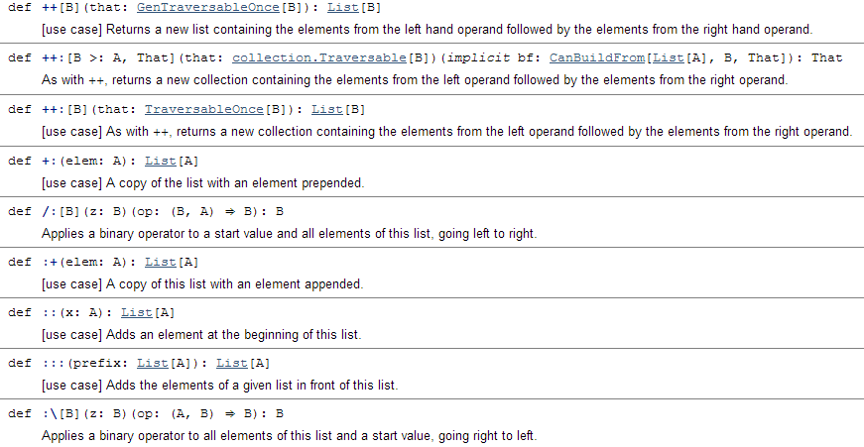
Function names (List)

Slide 32
Important things this session hasn’t covered
Implicit conversions
Lazy keyword
Streams
Apply method
Option, Try, Nothing types
Companion object
For expressions
Packages and imports

Slide 33
Resources
Programming Scala 2nd Edition – Martin Odersky et al
Scala for the impatient – Cay Horstmann
Functional Programming principles in Scala course – Coursera

Slide 34
Want to know more?
Play Framework for Scala developers
RESTful Web APIs with Spray
RESTful Web APIs with Play Framework
Scala Futures
Akka with Scala
Data Access with Slick
Play Framework for Java developers

Slide 35
Questions?
Thank you!

